Slide 1

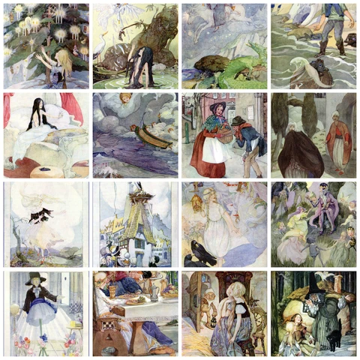

Theme & Conflict &
Fairy Tales

Slide 2
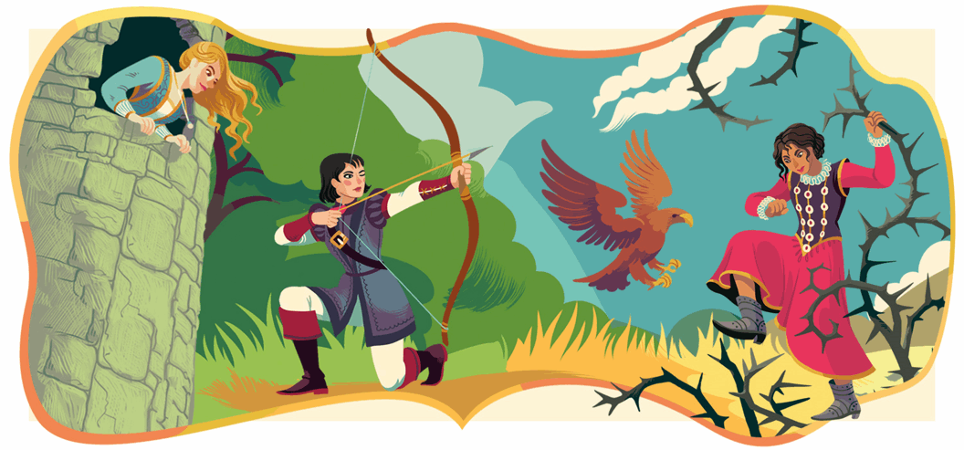
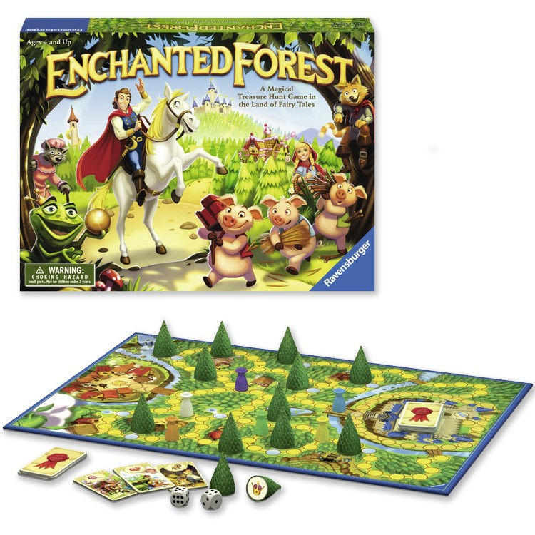
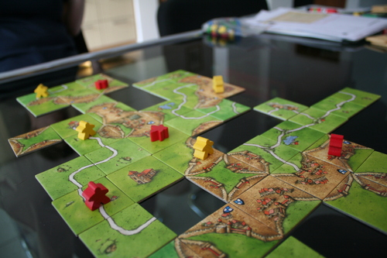
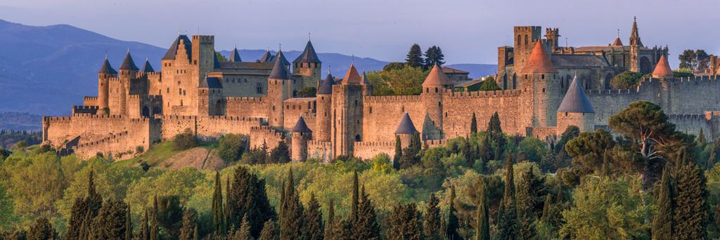
Theme
The utilization of a specific scenario world in which to immerse players.

Slide 3
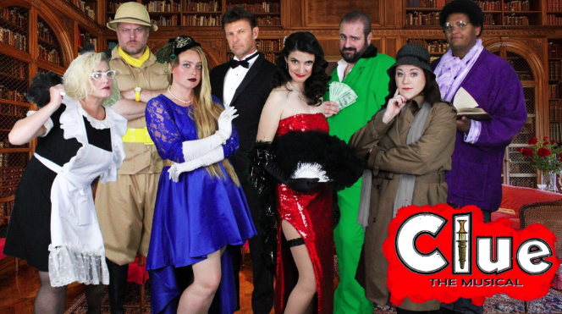
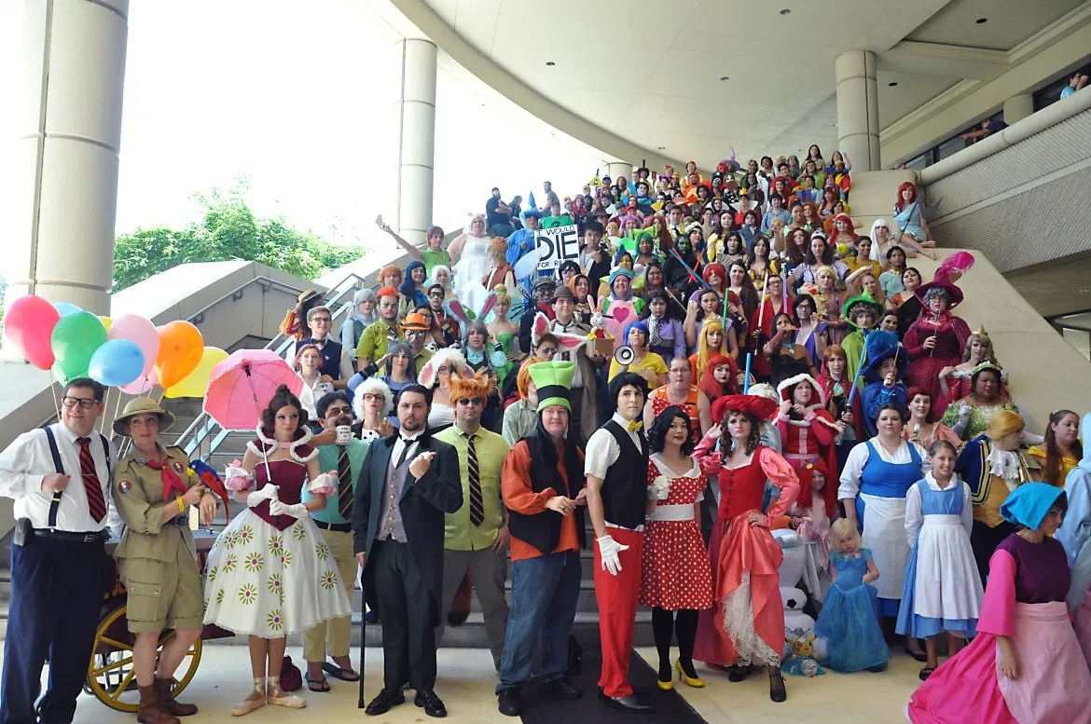
Theme
Themes let players play pretend!

Slide 4
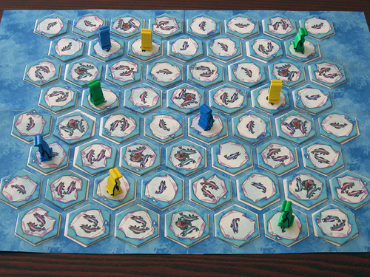
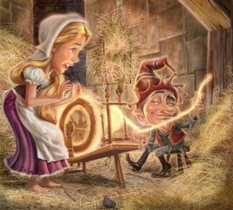
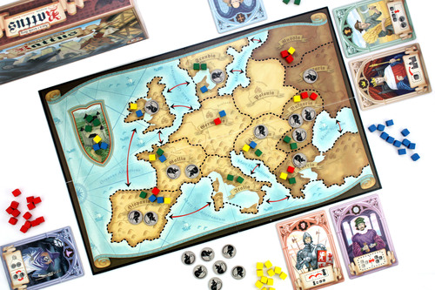
Theme
Themes provide context to help players remember the rules of a game.

Slide 5
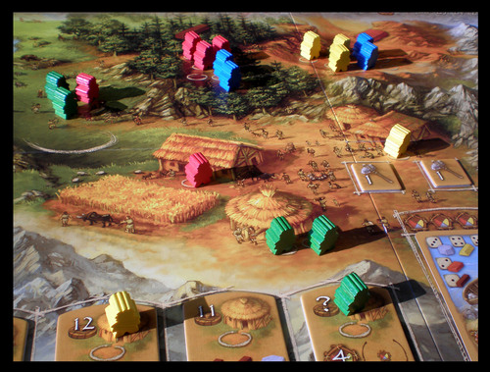
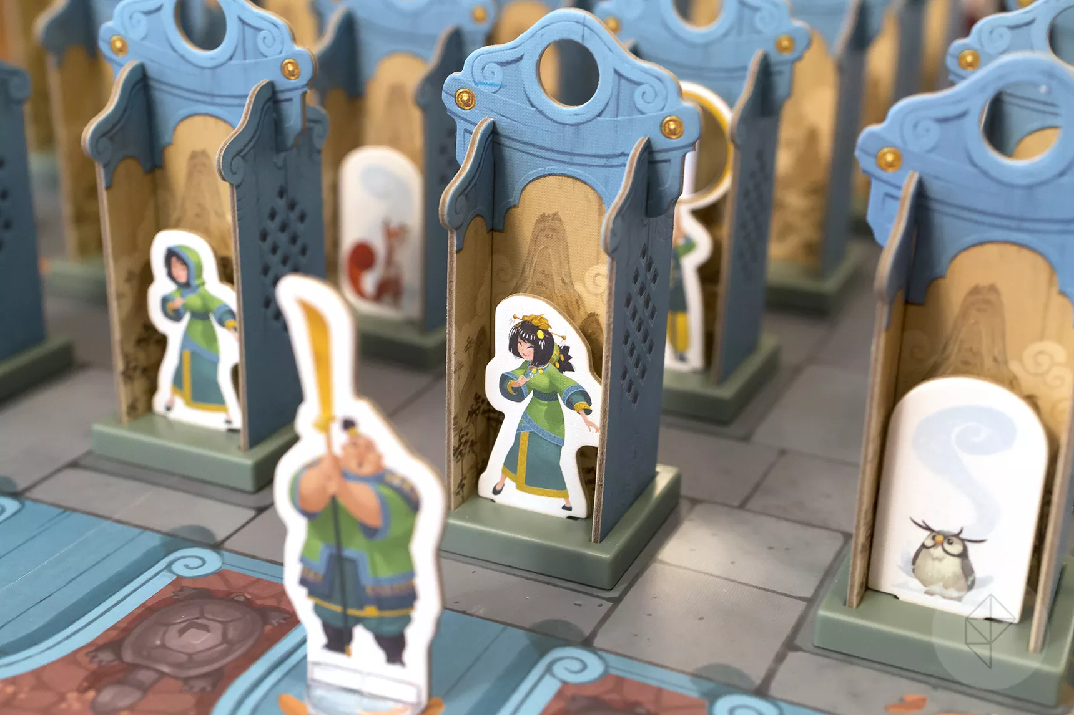
Theme
Theme can also put players in the right frame of mind to make better, more informed decisions because they can use existing knowledge about a subject to help them.

Slide 6
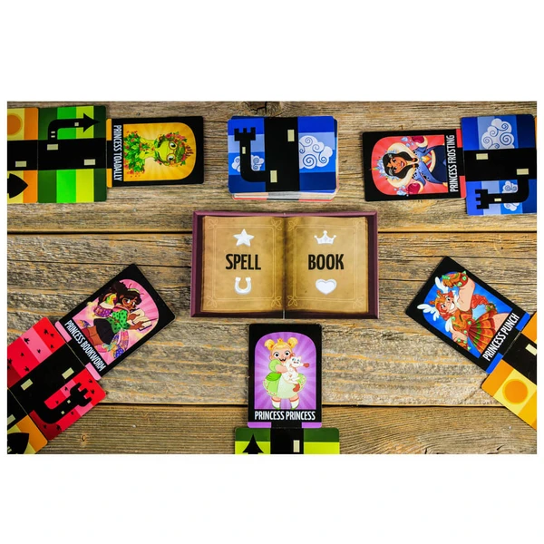
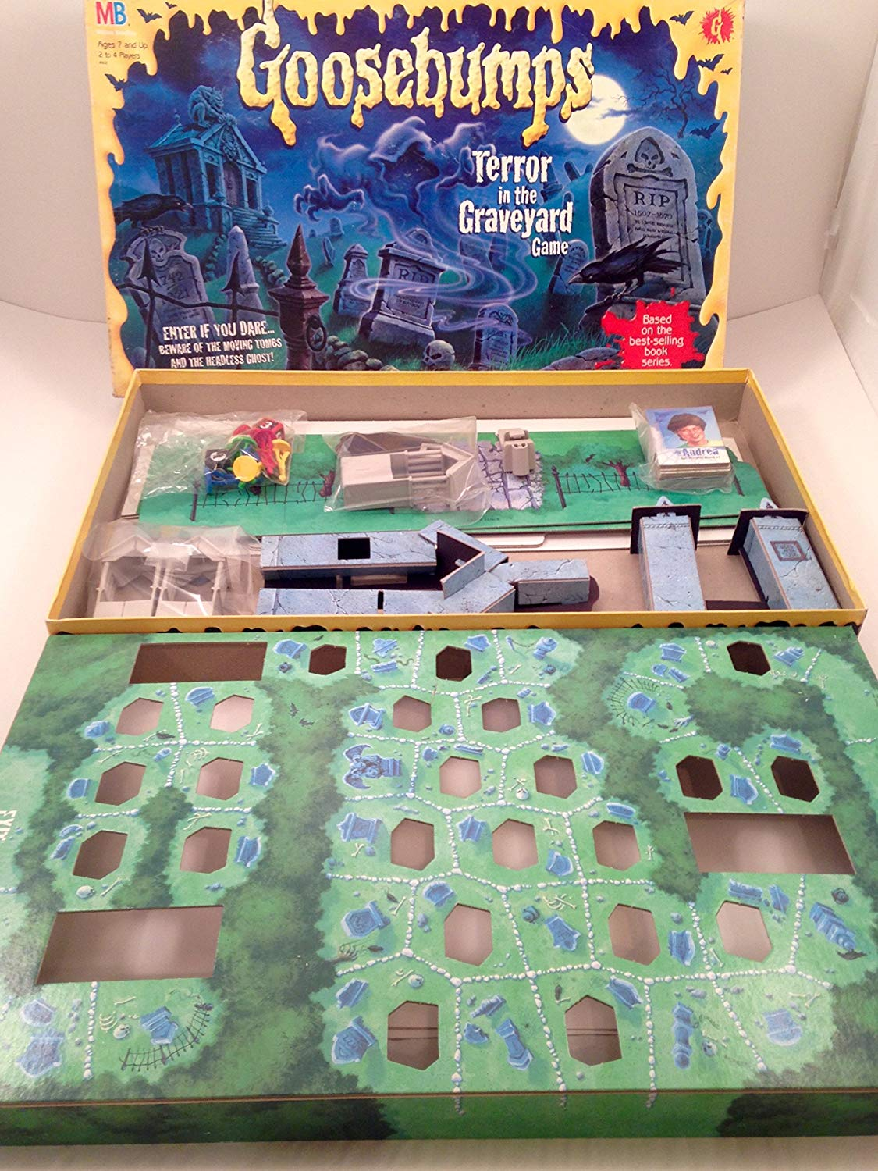
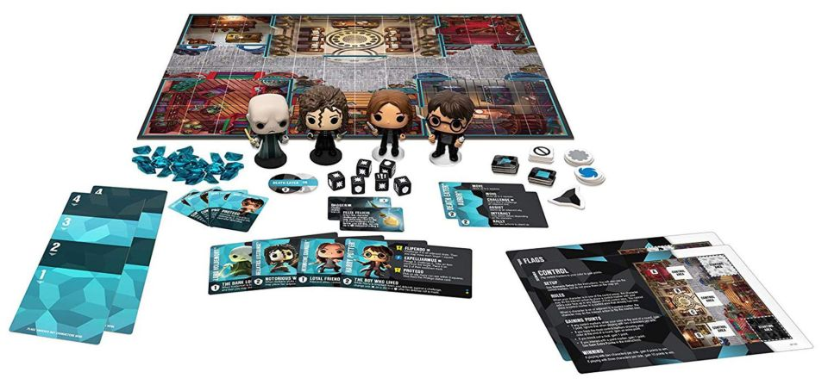
Theme
Players want the game’s theme and game experience to match their expectations.

Slide 7
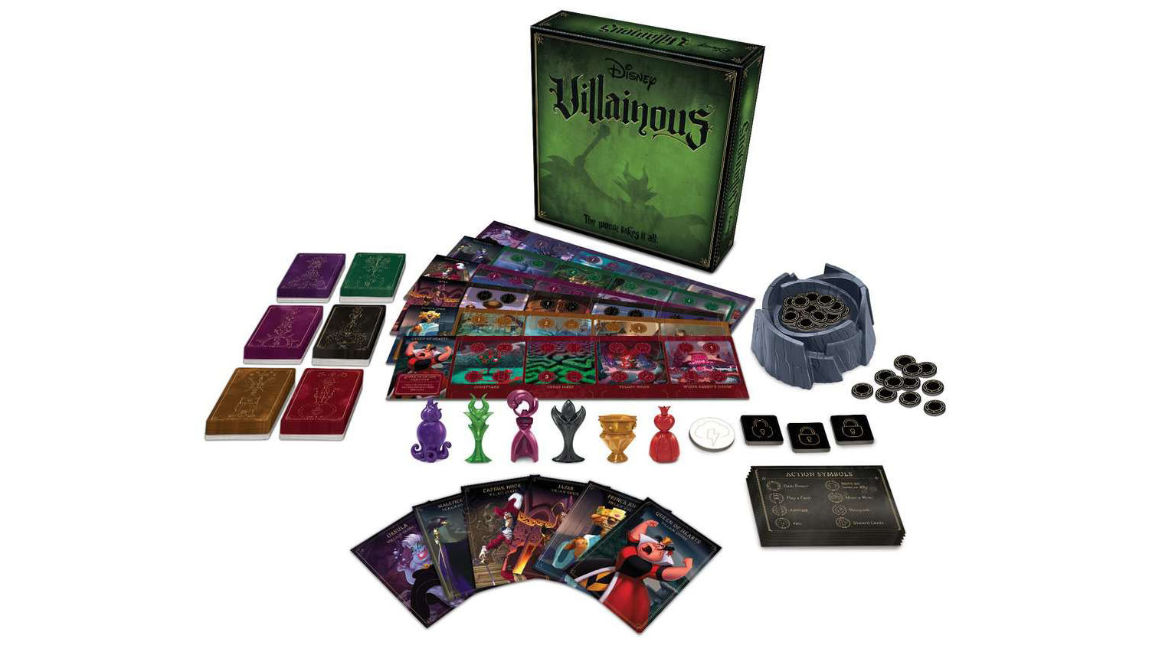
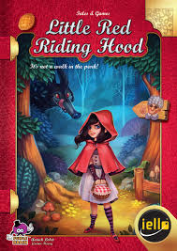
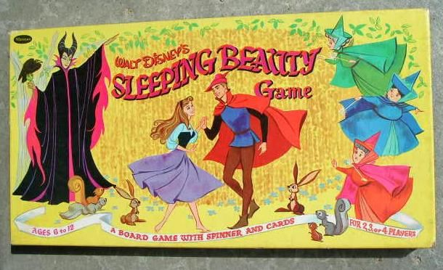
Your Game’s Theme
What fairy tales do you think have a compelling story?
What is the conflict in the story?
How can that conflict be gamified?

Slide 8
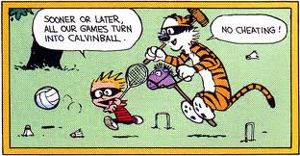
Conflict in Games

Slide 9
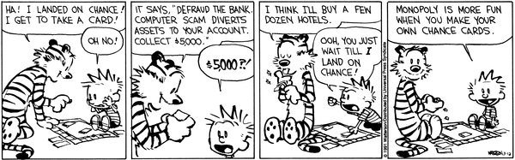
Conflict in Game Design
Games have conflict.
But what does this mean for you as a designer?

Slide 10
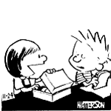
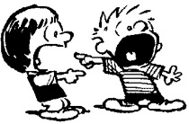
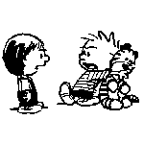
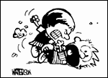
Which Picture Shows Conflict?

Slide 11
Definition of Conflict
The mental struggle resulting from
incompatible or opposing
needs, drives, wishes, or external or internal demands.
(Merriam Webster)

Slide 12

Activity vs. Game
Without conflict, games become an activity.
Activity:
Playing Apples to Apples casually, just making yourselves laugh, not really caring about score.
Game:
Playing Apples to Apples with fierce intensity, trying to crush all opponents to win.

Slide 13
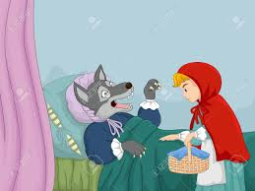
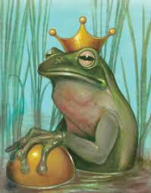
Three Types of Conflict
You want something, and someone else wants it too.
You want to do something, and someone else gets in the way.
Someone else has something, and you want it.
How does the game’s story (or specific parts of the story) fit one of these types of conflict?

Slide 14
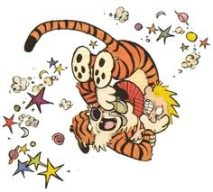
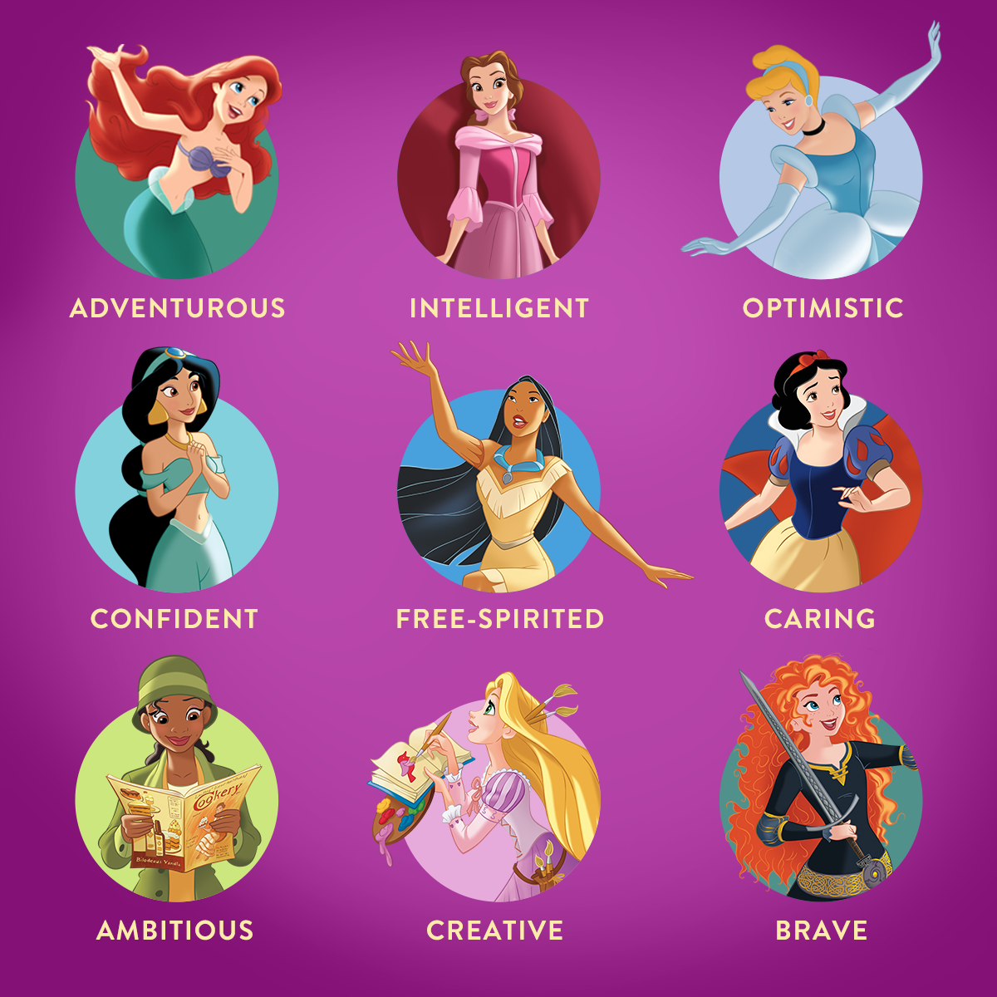
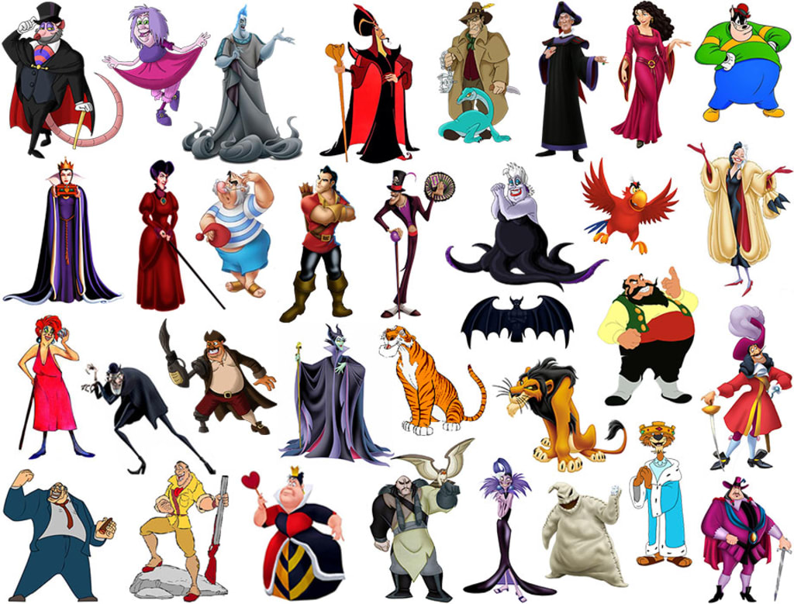
Your Task
How can you gamify the conflict of a story?

Slide 15
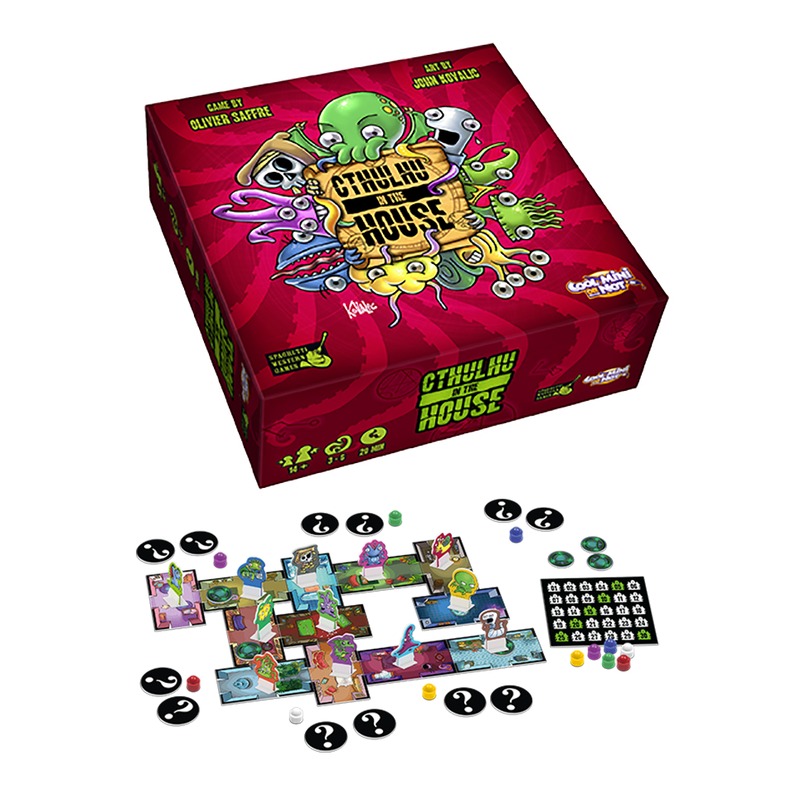

Conflict: Large
Large Scale: the goal must present conflict that affects everyone.
Example: Cthulhu in the House
Players are trying to stay in the house the longest to get the most points.
Example: Beauty and the Beast
Belle has to endure the Beast’s castle in order to save her father.

Slide 16
Conflict: Small Scale
Small Scale: Each player should experience some form of conflict on their turn.
Example: Cthulhu in the House
Which piece to move, yours or someone else’s? Who to pick in a battle? Which portal to choose? If I move my piece, will others figure out that it’s mine? If I don’t pick my piece, will others figure out which one is mine? Etc.
Example: Beauty and the Beast
The castle’s furnishings are alive, Gaston threatens the Beast, Belle has to learn to trust the Beast and vice versa

Slide 17
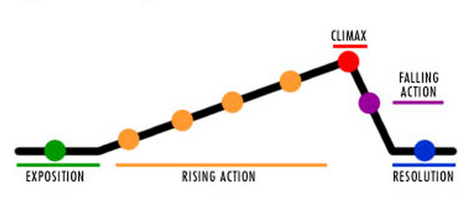
Conflict Drives
a Game’s Story

Slide 18
A Refresher on Plot
Exposition
the beginning; characters, setting, conflict are introduced
Rising Action
the series of events leading to the climax; excitement and tension build
Climax
the turning point of the story; the moment of highest interest and emotion.
Falling Action
the winding up of the story; events and complications begin to resolve and the result of actions of the main characters are seen
Resolution
the end of a story; ends with either a happy or a tragic ending.

Slide 19
A Board Game’s Plot
Exposition--Setup, Objectives, Rules
the beginning; characters, setting, conflict are introduced
Rising Action--Game Play
the series of events leading to the conflict; excitement and tension build
Climax--End of the Game is Triggered
the turning point of the story; the moment of highest interest and emotion.
Falling Action--Scoring
the winding up of the story; events and complications begin to resolve and the result of actions of the main characters are seen
Resolution--Determining a Winner
the end of a story; ends with either a happy or a tragic ending.

Slide 20
Mary Had a Little Lamb
Exposition
Rising Action
Climax
Falling Action
Resolution
Mary Had A Little Lamb (poem)
Mary had a little lamb,
Its fleece was white as snow.
Everywhere that Mary went
The lamb was sure to go.

Slide 21
Mary Had a Little Lamb wicked
Exposition
Rising Action
Climax
Falling Action
Resolution
Mary Had A Little Lamb (poem)

Slide 22
Mary Had a Little Lamb wicked
Exposition
Rising Action
Climax
Falling Action
Resolution
Mary Had A Little Lamb (poem)
Mary had a little lamb,

Slide 23
Mary Had a Little Lamb wicked
Exposition
Rising Action
Climax
Falling Action
Resolution
Mary Had A Little Lamb (poem)
Mary had a little lamb,
Her father shot it dead.

Slide 24
Mary Had a Little Lambwicked
Exposition
Rising Action
Climax
Falling Action
Resolution
Mary Had A Little Lamb (poem)
Mary had a little lamb,
Her father shot it dead.
Now it goes to school with her

Slide 25
Mary Had a Little Lamb wicked
Exposition
Rising Action
Climax
Falling Action
Resolution
Mary Had A Little Lamb (poem)
Mary had a little lamb,
Her father shot it dead.
Now it goes to school with her
Between two hunks of bread.

Slide 26
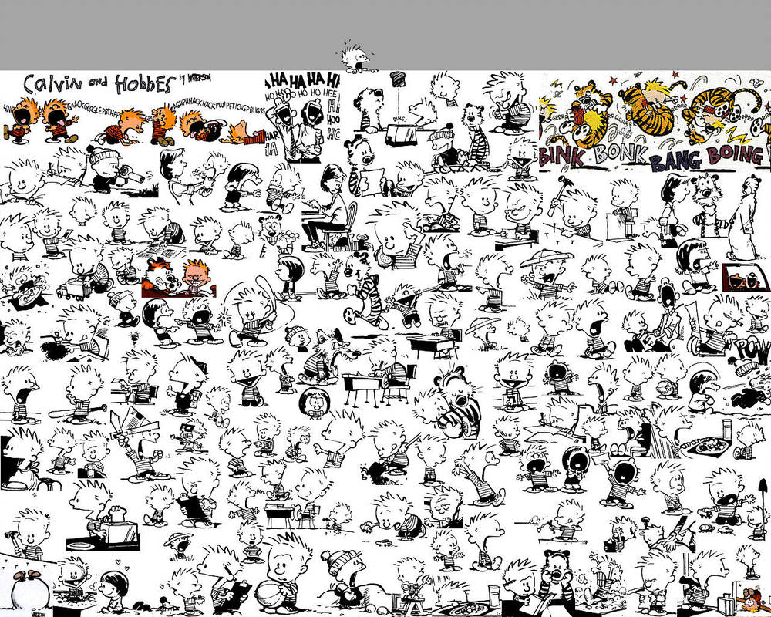
Conflict makes games compelling!

Slide 27
Conflict: Large & Small Scale
Large Scale: the goal must present conflict that affects everyone.
Survive: Escape from Atlantis!
Each player is competing to get the most points from meeples rescued from the island.
Small Scale: each player should experience some form of conflict on their turn.
Survive: Escape from Atlantis!
Which tile to play, which three actions to take, which tile to remove, which monster to move

Slide 28
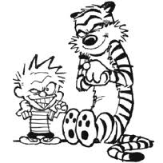
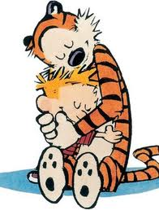
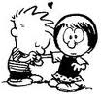
Conflict is Satisfying for Players!
Player engagement: It motivates players to start playing, and to keep playing.
Tension: Players need to have a sense that their game play is going somewhere, to some end, and it’s competitive.
Good conflict leads to players wanting to play the game again and again and again

Slide 29
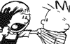
Your Turn
Choose three games you’ve played in class, and explain the large and small scale conflict players experience in each game.

Slide 30
Your Turn
Explain how a specific fairy tale has one of the three types of conflict:
You want something, and someone else wants it too.
You want to do something, and someone else gets in the way.
Someone else has something, and you want it.

Slide 31
Fairy Tale
Game Design Project
Fairy Tales
Planning Document

